Slide 1


AI Saturdays Kickoff
AI6 Week 1
Oxygen AI
Optimize Your Outcomes
AI6 Registration Form: https://docs.google.com/forms/d/e/1FAIpQLSd0wx35dx1NJI2C_ciyzoplneu1igltvEACI5KLN6FPWrhO8w/viewform
Notes:
AI6 Registration Form: https://docs.google.com/forms/d/e/1FAIpQLSd0wx35dx1NJI2C_ciyzoplneu1igltvEACI5KLN6FPWrhO8w/viewform

Slide 2
Agenda
845AM – Sign-in
910AM - Fast AI Discussion
10AM - Break
1030AM - CS224n Discussion
1130 - Break
12PM Close
Fast AI Lesson 1
CS224n Lecture 1
Other Items
Interest in MXNet
Study Kera-based FastAI

Slide 3
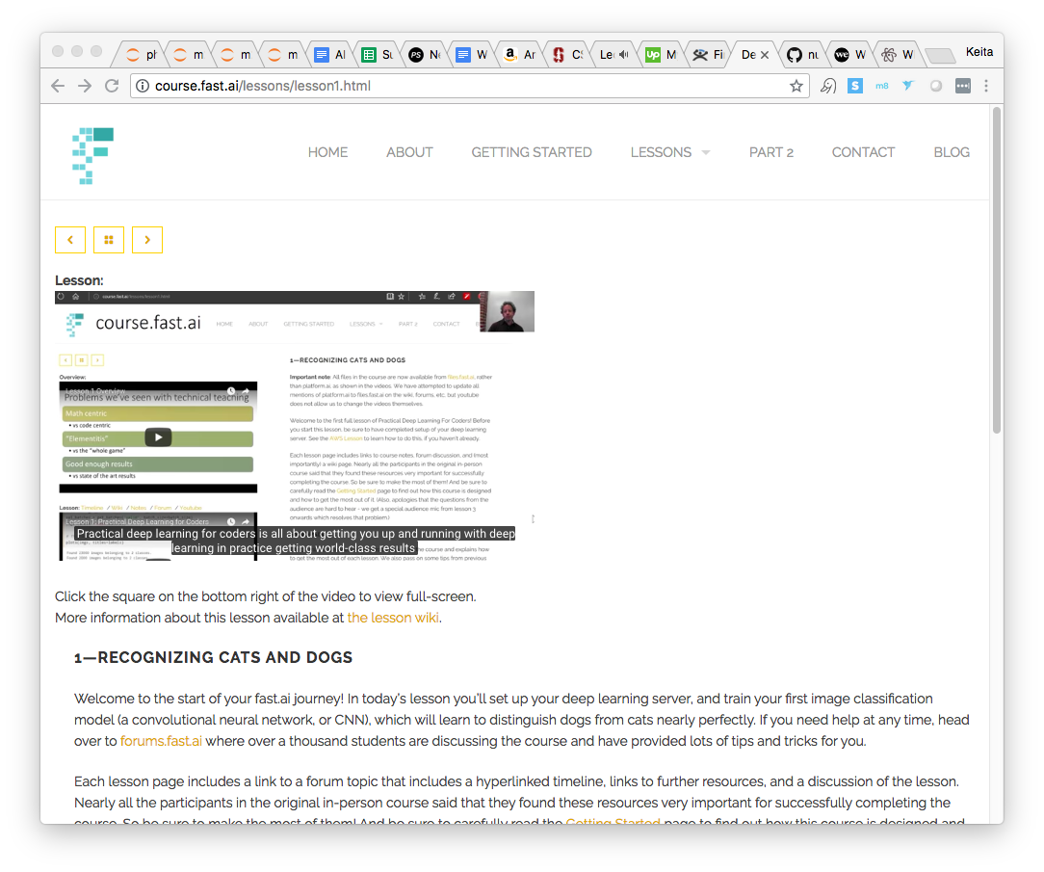
Fast AI – Week 1
Pre-Work
Video: http://course.fast.ai/lessons/lesson1.html
Lesson Wiki: http://forums.fast.ai/t/wiki-lesson-1/9398
Reading: Found in Lesson Wiki
Coding Goals:
Minimum: run through the Notebook and understand it
Ideal: Recreate the code from scratch without aid

Slide 4
Fast.AI Lesson 1:
Recognizing Cats and Dogs
Key Coding Concepts
Use of Jupyter Notebooks and Tricks
Use of ! for in-Notebook bash(shell) operations
Folder Structure for Image Classification
Python 3 conventions
format strings
Image File Format
The 3 Lines Used to Train the Model
Specify the Data
Specify the Model
Train the Model
Learning Rate; LR functions
lr_find() , plot_lr() , sched.plot()
Creating customized functions to view/check/visualize results and data

Slide 5
Fast.AI Lesson 1:
Recognizing Cats and Dogs
Key Theoretical Concepts
Training and Validation Sets
Logs and Natural Logs
”Infinitely Flexible” functions: Neural Networks
Convolutions
Convolutional Neural Networks
Gradient Descent
Learning Rate
Stochastic Gradient Descent
Notes:
AI6 Registration Form: https://docs.google.com/forms/d/e/1FAIpQLSd0wx35dx1NJI2C_ciyzoplneu1igltvEACI5KLN6FPWrhO8w/viewform

Slide 6
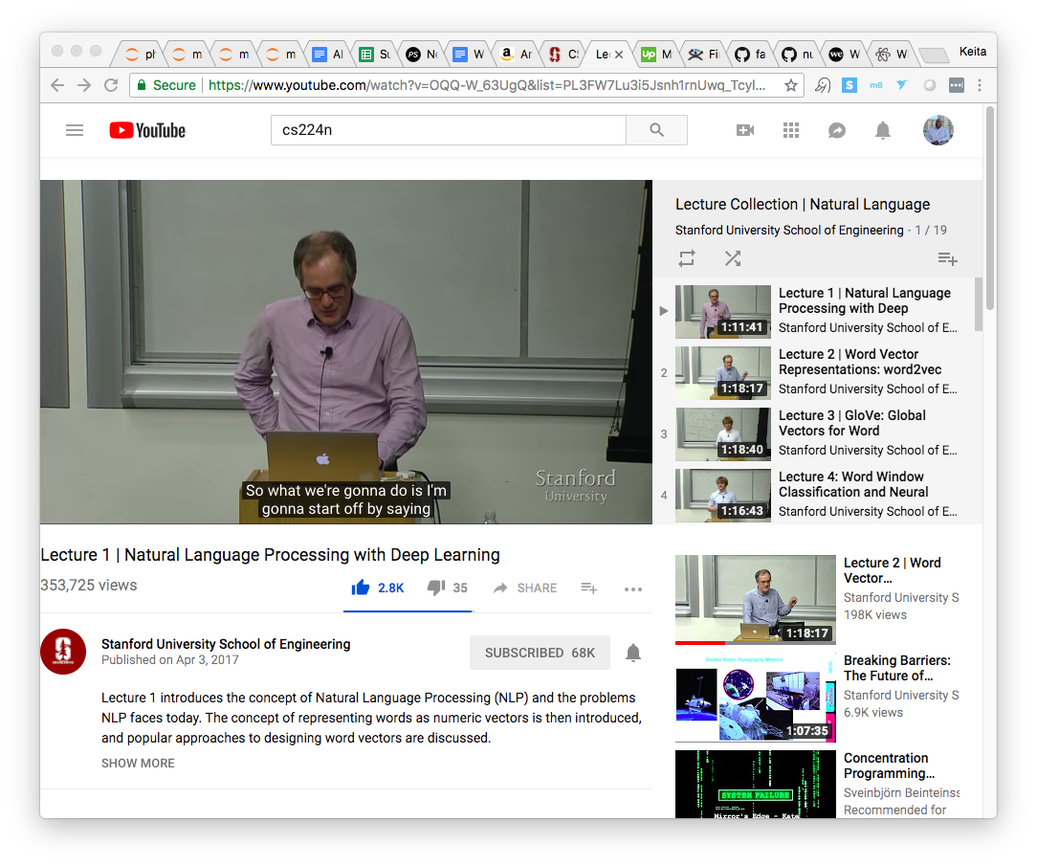
CS224n – Week 1
Intro to NLP & Deep Learning
Pre-Work
Video:
https://www.youtube.com/watch?v=OQQ-W_63UgQ&list=PL3FW7Lu3i5Jsnh1rnUwq_TcylNr7EkRe6
Slides: http://web.stanford.edu/class/cs224n/lectures/lecture1.pdf
Reading:
[Linear Algebra Review]
[Probability Review]
[Convex Optimization Review]
[More Optimization (SGD) Review]

Slide 7
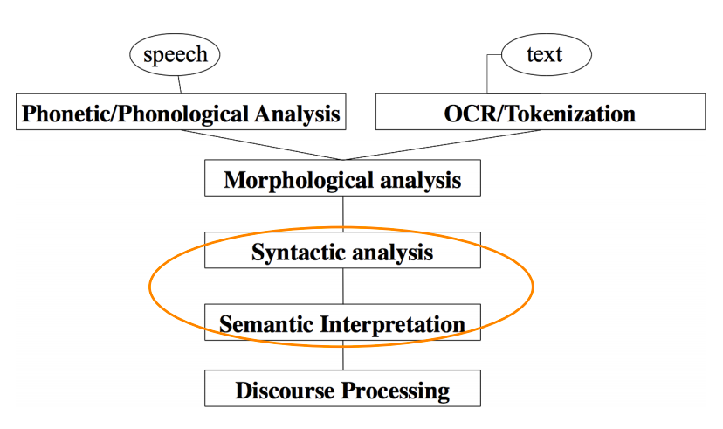
CS224n Lecture 1
Key Theoretical Concepts
NLP Levels
Inputs: Speech and Text and their Processing
Working out the parts of complex words
Working out the structure of sentences
Working out the meaning of sentences
Meaning of sentences given greater context
Representations
”Infinitely Flexible” functions: Neural Networks
Convolutions
Convolutional Neural Networks
Gradient Descent
Learning Rate
Stochastic Gradient Descent
Notes:
AI6 Registration Form: https://docs.google.com/forms/d/e/1FAIpQLSd0wx35dx1NJI2C_ciyzoplneu1igltvEACI5KLN6FPWrhO8w/viewform

Slide 8
Backup

Slide 9
Curriculum
Fast.ai - Practical Deep Learning For Coders - Part 1
Stanford CS224n: NLP with Deep Learning

Slide 10
Fast AI Detailed Overview
“Learn how to build state of the art models without needing graduate-level math—but also without dumbing anything down.”
Weekly Course Content
Recognizing Cats and Dogs
Improving Your Image Classifier
Understanding Convolutions
Structured, Time Series & Language Models
Collaborative Filtering. Inside the Training Loop
Interpreting Embeddings. RNN from Scratch
Resnets from Scratch

Slide 11
CS224n Detailed Overview
Weekly Course Content
Intro to NLP & Deep Learning
Word Vectors 1
Word Vectors 2
Neural Networks
Back Propagation
Intro to TensorFlow
Dependency Parsing
RNN and Language Models
Vanishing Gradients, Fancy RNNs
Machine Translation, Seq2Seq and Attention
Advanced Attention
Transformer Networks and CNNs
Co-reference Resolution
Tree RNNs and Constituency Parsing
Advanced Architectures and Memory Networks
Reinforcement Learning for NLP
Semi-Supervised Learning for NLP
Future of NLP Models, Multi-task Learning and QA Systems
“Students will learn to implement, train, debug, visualize and invent their own neural network models.”
Notes:
Syllabus: http://web.stanford.edu/class/cs224n/syllabus.html

